Slide 1
Analysis of Transportation Services for Individuals with Intellectual and Developmental Disabilities
Rob Gregg
Jay Goodwill
August 2, 2017 l Tallahassee, Florida

Slide 2
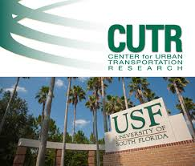
Overview
We Are CUTR
Overview: Public Transportation Service Networks in Florida
Topical Studies
Resources / Best Practices Sampler
Research Analysis Focus

Slide 3


We are CUTR…..
National, State and Local
Founding Legislation Chapter 334.065 F.S.
National Center for Transportation Research
FDOT
Compliance
Technical Assistance
Training
Professional Development Networks
State Agencies / Local Governments
CTD
Transit Agencies
Counties / Cities / Urban / Rural

Slide 4




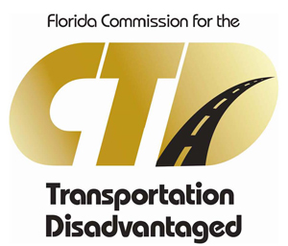

Brief: Public Transportation Service Networks in Florida
Funding Programs
FTA
5307 Urban / General / ADA
5310 Seniors / Persons w Disabilities
5311 Rural / General / ADA
FDOT
FTA Sub-recipients
Service Development
Contribute to TD
CTD
Non Sponsored
Seniors / Low Income / Persons w Disabilities
Local
Public Transit Agencies / CTC’s
Match FTA / FDOT / CTD
Human Service Agencies Support
Special Districts

Slide 5
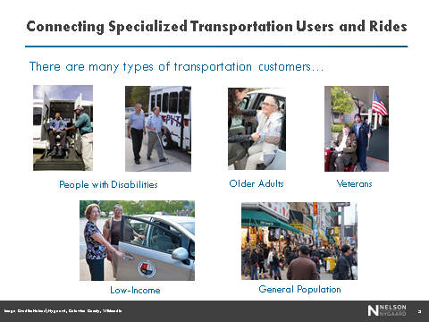
Different Users and Riders

Slide 6
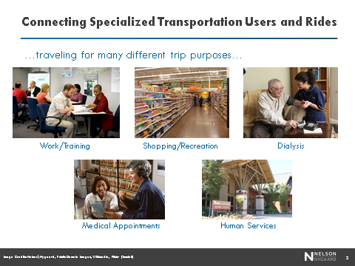
Different Trip Purposes

Slide 7
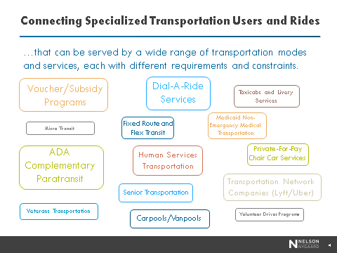
Different Mobility Services

Slide 8
Topical Studies and Research (Selective Samples)
TCRP REPORT 163: Strategy Guide to Enable and Promote the Use of Fixed-Route Transit by People with Disabilities
TRANSPORTATION RESEARCH BOARD, WASHINGTON, D.C. 2013
Innovative Approaches for Increasing Transportation Options for People with Disabilities in Florida
FLORIDA DEVELOPMENTAL DISABILTIES COUNCIL, INC., APRIL 2010
By: USF Center for Urban Transportation Research
Forecasting Paratransit Services Demand – Review and Recommendations
NATIONAL CENTER FOR TRANSPORTATION RESEARCH AND FLORIDA DEPARTMENT OF TRANSPORTATION, JUNE 2013
By: USF Center for Urban Transportation Research
Impacts of Dialysis Transportation on Florida’s Coordinated Public Transportation Programs
NATIONAL CENTER FOR TRANSPORTATION RESEARCH AND FLORIDA DEPARTMENT OF TRANSPORTATION, APRIL 2014
By: USF Center for Urban Transportation Research
Flexible Public Transportation Services in Florida
NATIONAL CENTER FOR TRANSPORTATION RESEARCH AND FLORIDA DEPARTMENT OF TRANSPORTATION, AUGUST 2013
By: USF Center for Urban Transportation Research
Creative Ways to Manage Paratransit Costs
NATIONAL CENTER FOR TRANSPORTATION RESEARCH AND FLORIDA DEPARTMENT OF TRANSPORTATION, JULY 2008
By: USF Center for Urban Transportation Research
Independent Assessment of the Florida Medicaid NET Program
LOUIS DE LA PARTE FLORIDA MENTAL HEALTH INSTITUTE AT THE UNIVERSITY OF SOUTH FLORIDA, SEPTEMBER 2016
Florida Transportation Disadvantaged Program Historic Policy and Funding Allocation Process Assessment
FLORIDA COMMISSION FOR THE TRANSPORTATION DISADVANTAGED, FEBRUARY 2017
By: USF Center for Urban Transportation Research
Unmet and Latent Demand for Transportation Disadvantaged Services
FLORIDA COMMISSION FOR THE TRANSPORTATION DISADVANTAGED, JANUARY 2014
By: USF Center for Urban Transportation Research
A Review of Compliance Requirements and Responsibilities for Transportation Services of Public Sponsored Programs and the Relationship of a Local for Hire Ordinance
FLORIDA DEPARTMENT OF TRANSPORTATION, JANUARY 2016
By: USF Center for Urban Transportation Research
Disability Etiquette for Transit Operators Training
FLORIDA DEPARTMENT OF TRANSPORTATION, OCTOBER 2010
By: USF Center for Urban Transportation Research
Americans with Disabilities Act (ADA) Complementary Transit Services Analysis
CITY OF TALLAHASSEE – STARMETRO, MARCH 2016
By: USF Center for Urban Transportation Research

Slide 9




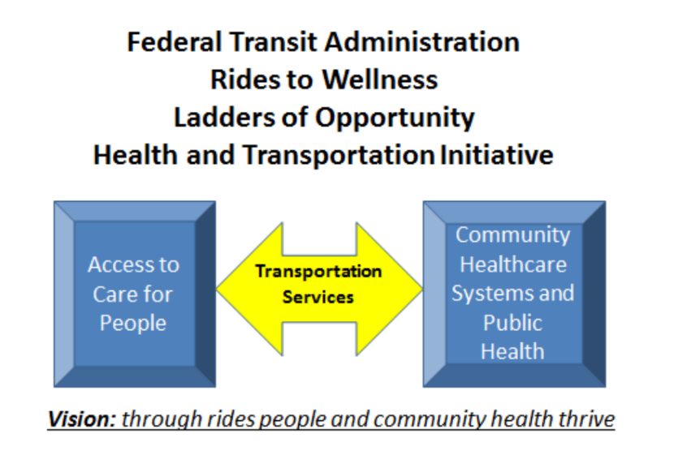

Resource / Best Practices Sampler

Slide 10
Samples of Best Practices
Use of Taxis
Travel Training
Operator Training
Technology
Fare Incentive Programs
Regional Call Centers
Bus Stop Design
First Mile / Last Mile
Coordination and Partnerships
Mobility Management
Education (operators, users, public)
Vouchers
Innovative Service Approaches
Flexible Services

Slide 11
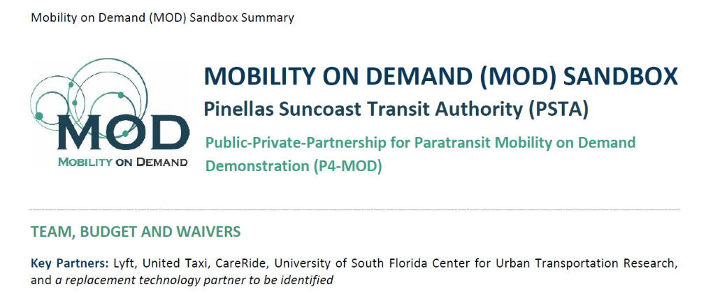
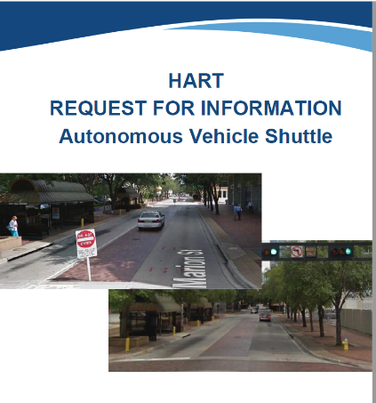
Solutions: Illustrations of Innovation
Technology
Business Partnerships
First / Last Mile
Automation

Slide 12
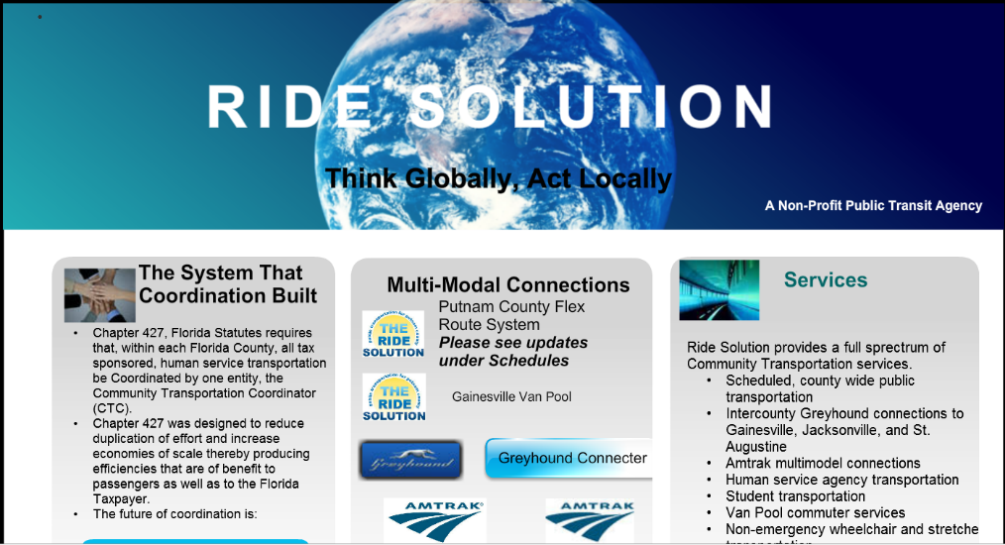

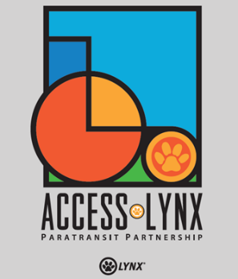
Illustrations of Innovation Solutions: Mobility Management
Customer Information
One-Click Call Center
Urban / Rural Connectivity
Travel Training
Sensitivity Training

Slide 13
Solutions: Regional Fare Systems
Regional Fare Policy and Fare Allocation, Innovations in Fare Equipment and Data Collection (2010) - Documents experiences related to regional fare programs in the United States, with an emphasis on institutional arrangements, technological impacts, customer acceptance, data processing enhancements, and costs and benefits.
Ridership Impacts of South Florida’s EASY Smart Card (2013) – Analyzes Miami-Dade Transit (MDT) and Tri-Rail’s regional EASY card deployment experience related to ridership and customer service impacts.
Assessment of Mobile Fare Payment Technology for Future Deployment in Florida Phase I (2016) – Reviewed nationwide examples of mobile ticketing apps and provided case study examples for five agencies based on research and interviews and created a concept of operations for a future mobile app deployment in Florida .
Assessment of Mobile Fare Payment Technology for Future Deployment in Florida Phase II (underway) – Evaluation of a mobile payment pilot project for Star Metro and Big Bend Transit that enables the agency’s customers to utilize cell phones and a mobile payment app to purchase fare media that bus operators can visually validate. This phase involves focus groups, internal beta testing and up to 200 volunteers that will test the app and provide feedback on functionality and added convenience during a six month pilot project.

Slide 14

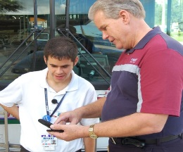
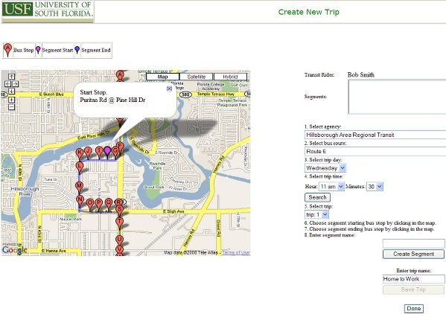
Travel Assistance Device (TAD) to Help Transit Riders
Philip L. Winters, Sean J. Barbeau, Nevine L. Georggi, Miguel A. Labrador, and Rafael A. Perez
Problem
TAD Cell Phone Application
Increasing use of fixed route transit services can increase the independence and quality of life of the cognitively disabled and reduce costs for transit agency relative to door-to-door service. According to travel trainers/ instructors who provide personalized guidance on how to use fixed-route transit, the three hardest skills to master in order for the cognitively disabled to use transit independently are watching for landmarks, recognizing one near the desired bus stop, and signaling to exit at the proper time.
Final Products
Solution
Bus Arrival Notification Using AVL and GPS-enabled Cell Phone
Conclusions
TAD System Architecture w/ AVL addition
Successfully demonstrated proof-of-concept:
Showing the estimated amount of time until the bus is expected to arrive while waiting at bus stop on cell phone.
Providing real-time vehicle locations on the map on the TAD website.
Without requiring the rider to supply additional information such as a bus stop ID or route number in order to receive the information because the above features are driven by the GPS location of the cell phone and bus,.
USF is actively pursuing the licensing of the TAD technology to offer TAD as a nationwide commercial service within the next year.
This IDEA product is an Automatic Vehicle Locator (AVL)-enhanced travel assistance device (TAD) that uses multimedia cell phones with built-in global positioning system (GPS) to overcome the challenges facing new riders or tourists, especially those who are cognitively disabled. The TAD cell phone app alerts the rider with real-time auditory, visual, and tactile prompts such as “Get Ready…” and “Pull the Cord Now!” when it is time for the rider to exit the bus at their destination stop, and shows the estimated time until bus arrival. Automated alarms can remotely alerted travel trainer and/or parent/guardian if a rider deviates from their predetermined path.
Online Trip Planner Saves Trip to Cell Phone
Center for Urban Transportation Research with the Department of Computer Science and Engineering
For more info, contact:
Phil Winters winters@cutr.usf.edu
Sean Barbeau barbeau@cutr.usf.edu
813.974.3120
www.locationaware.usf.edu
Research funded by the TRB Transit Innovations Deserving Exploratory Analysis (IDEA) program

Slide 15
Contact Information: Rob Gregg
gregg@cutr.usf.edu
Jay Goodwill
jaygoodwill@cutr.usf.edu

